Slide 1
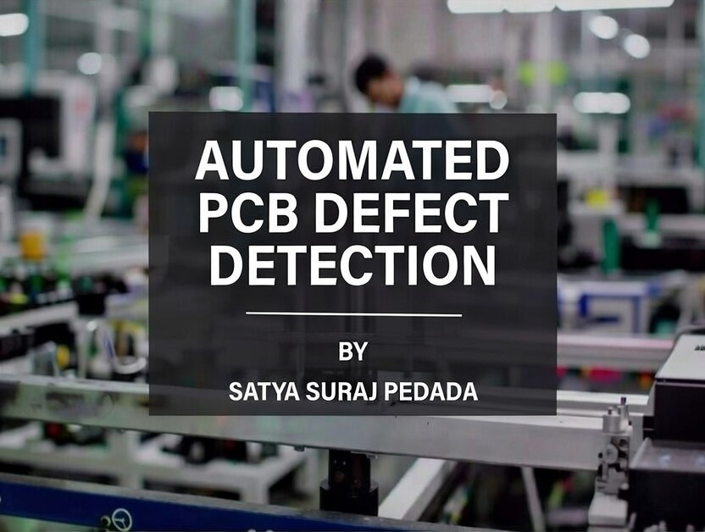

Slide 2

INTRODUCTION
PCBs → Heart of every electronic device (mobile, laptop, car, satellite)
Even small manufacturing defects → Device failure + High cost + Safety risk
Traditional methods have serious limitations:
Manual inspection → Slow, tiring, human error
Rule-based AOI → High false positives, misses
tiny/complex defects
Growing need for:
Fast & accurate defect detection
Precise location (not just yes/no)
Clear visual output for operators
Project Goal: Build intelligent automated system using Deep Learning (YOLOv8) + Web Interface

Slide 3
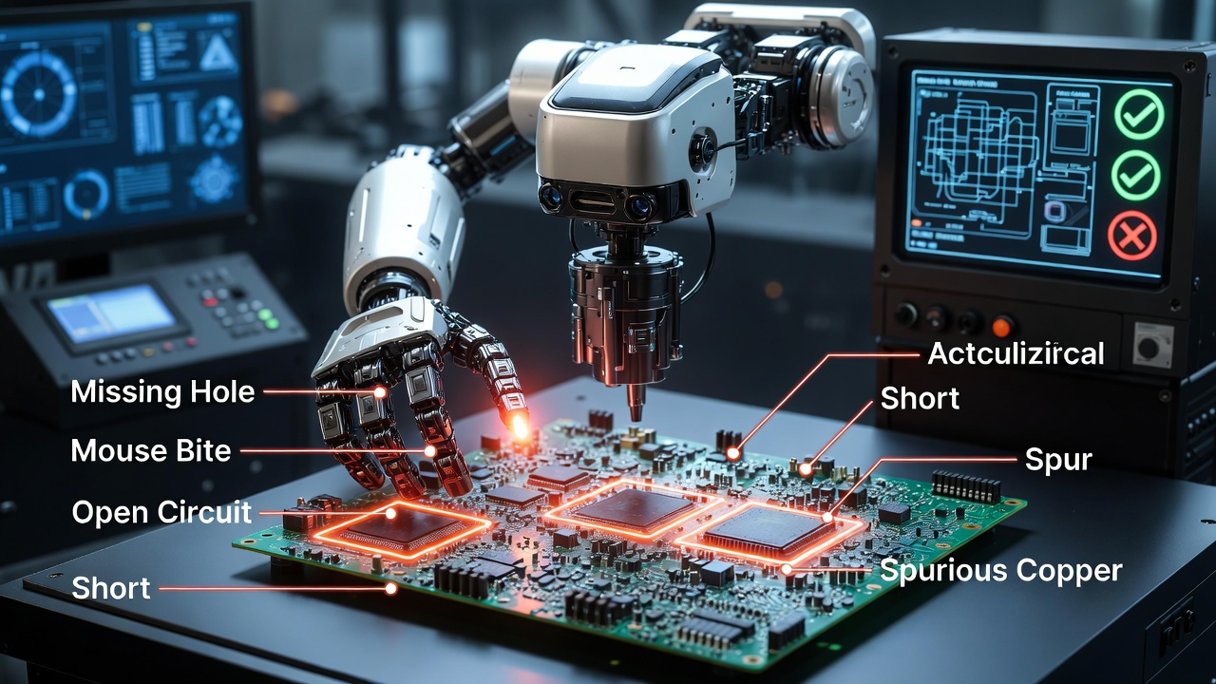
Problem Statement & Motivation
PCBs are critical → defects cause failures, cost, safety risks
Common defects: Missing Hole, Mouse Bite, Open Circuit, Short, Spur, Spurious Copper
Limitations
Manual inspection → slow, inconsistent
Rule-based AOI → high false positives, misses
subtle defect
Need: Accurate localization + real-time visual feedback

Slide 4
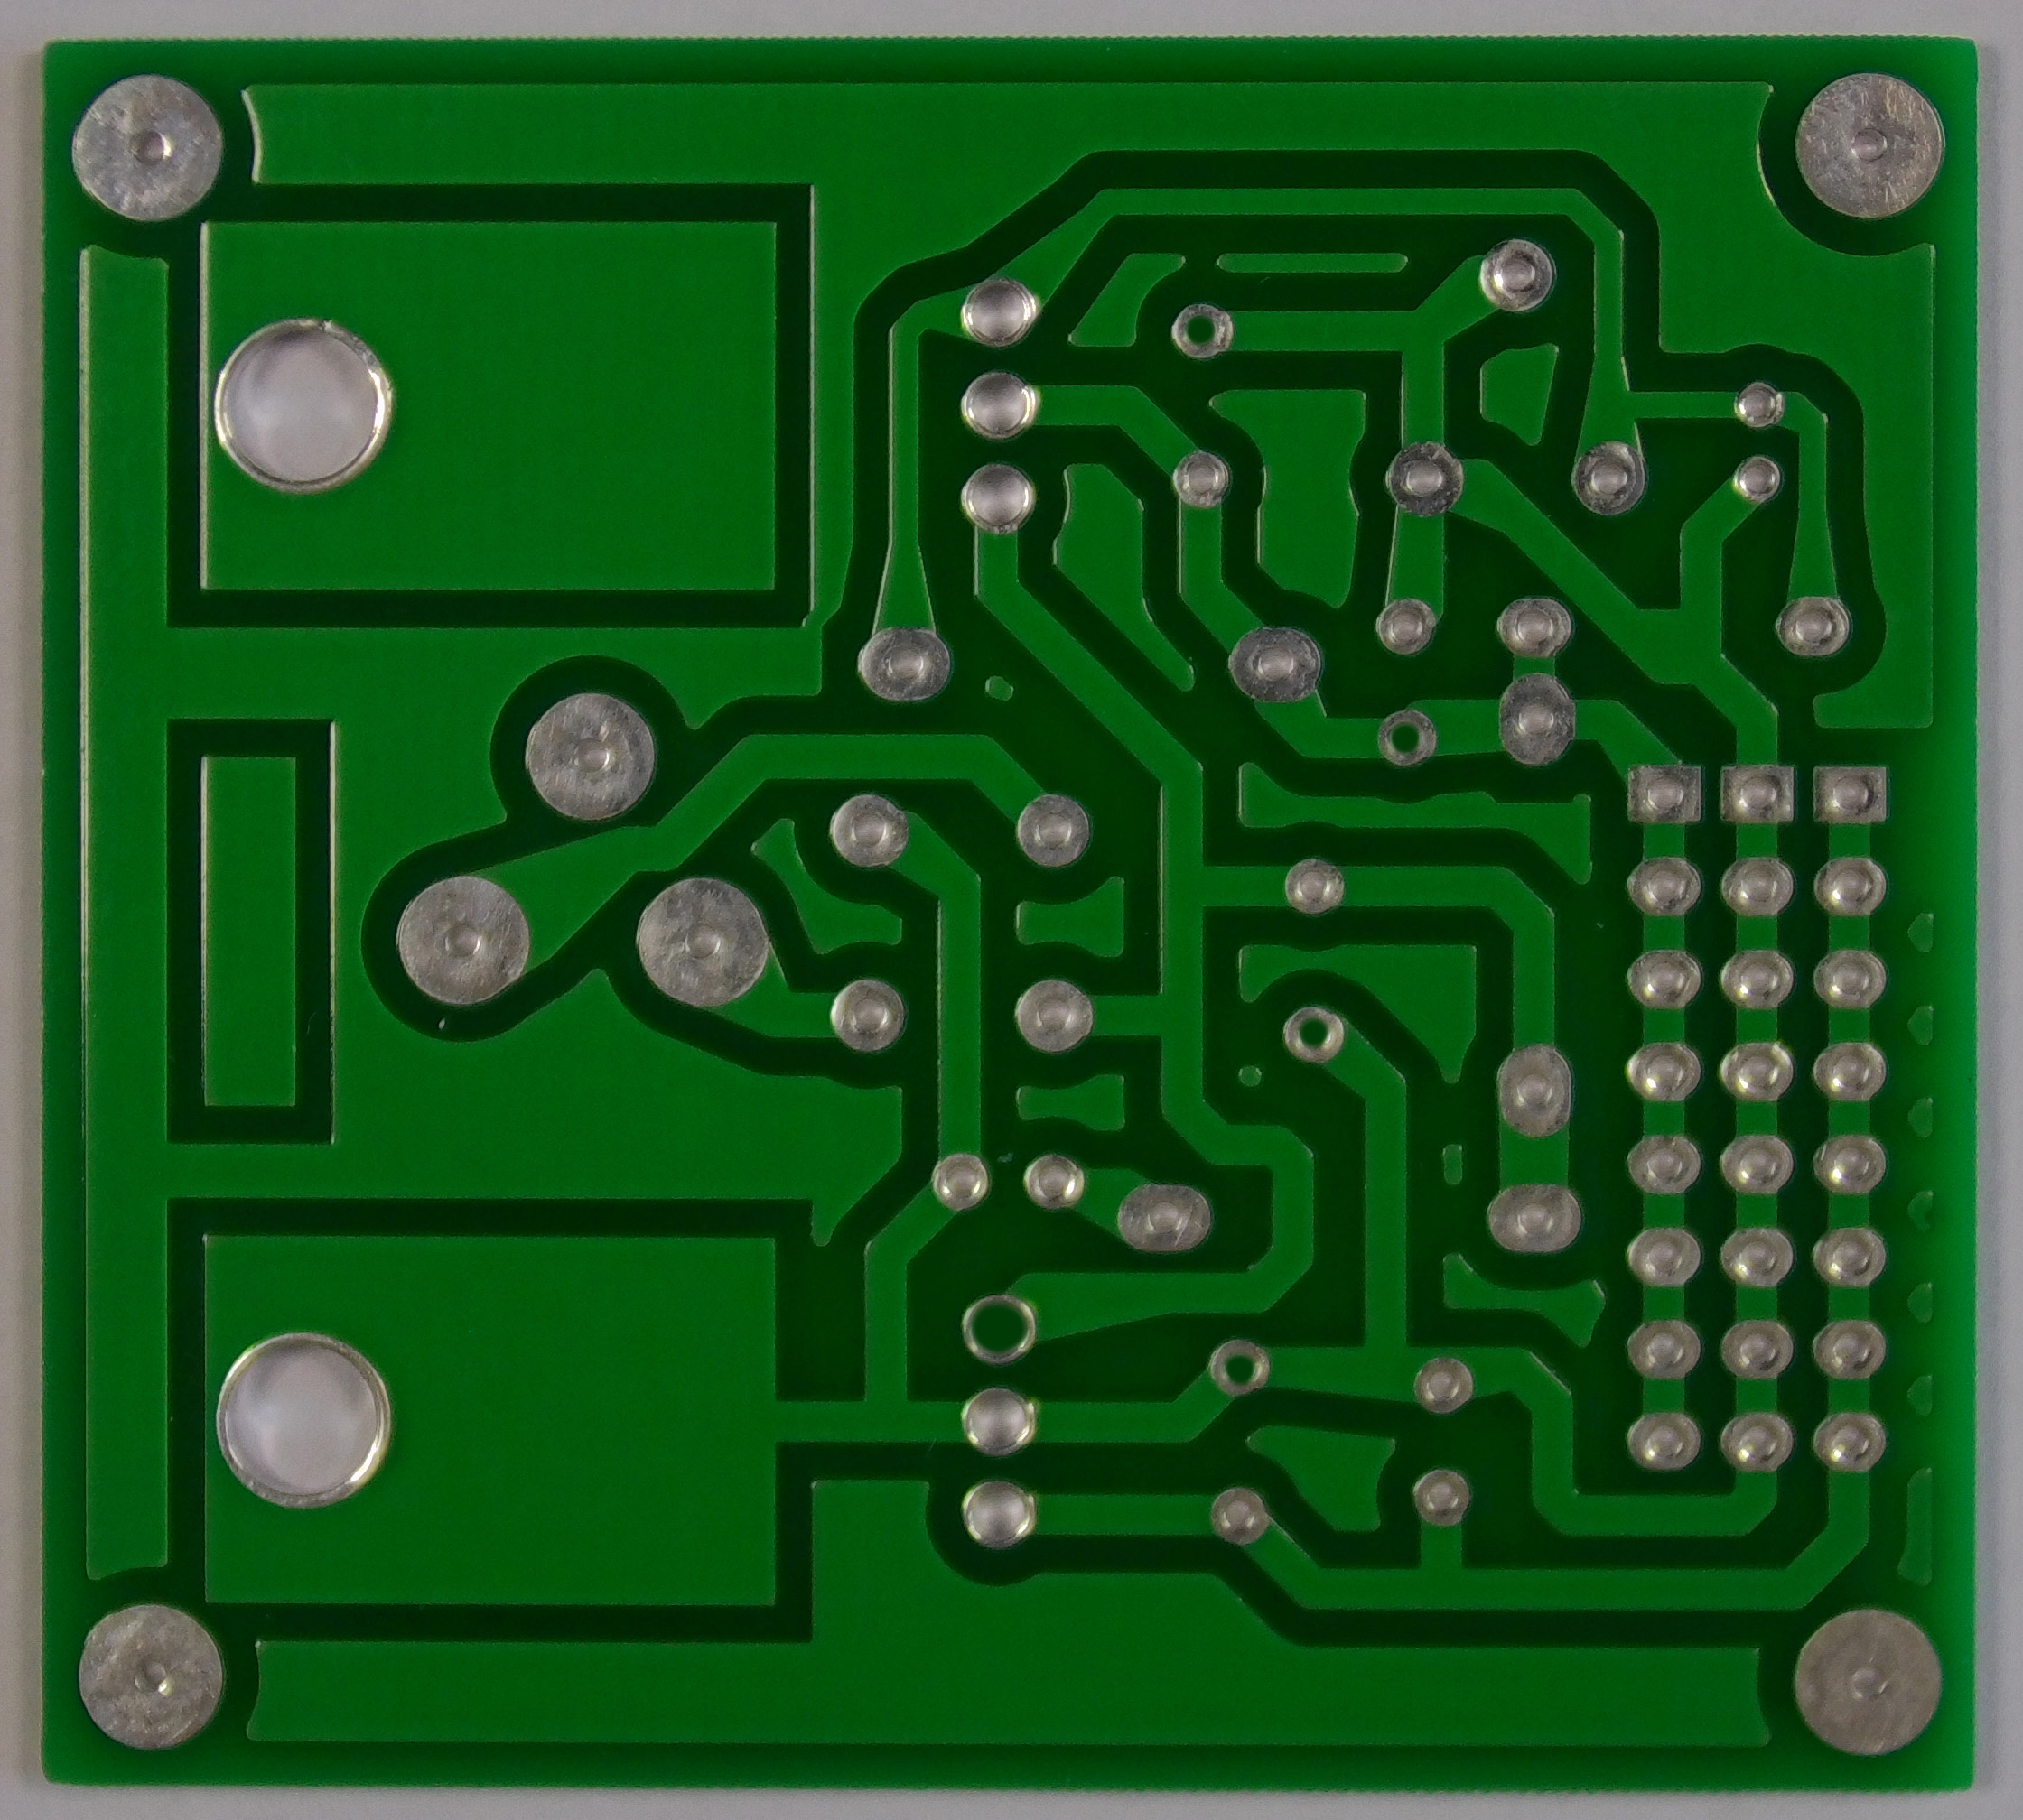
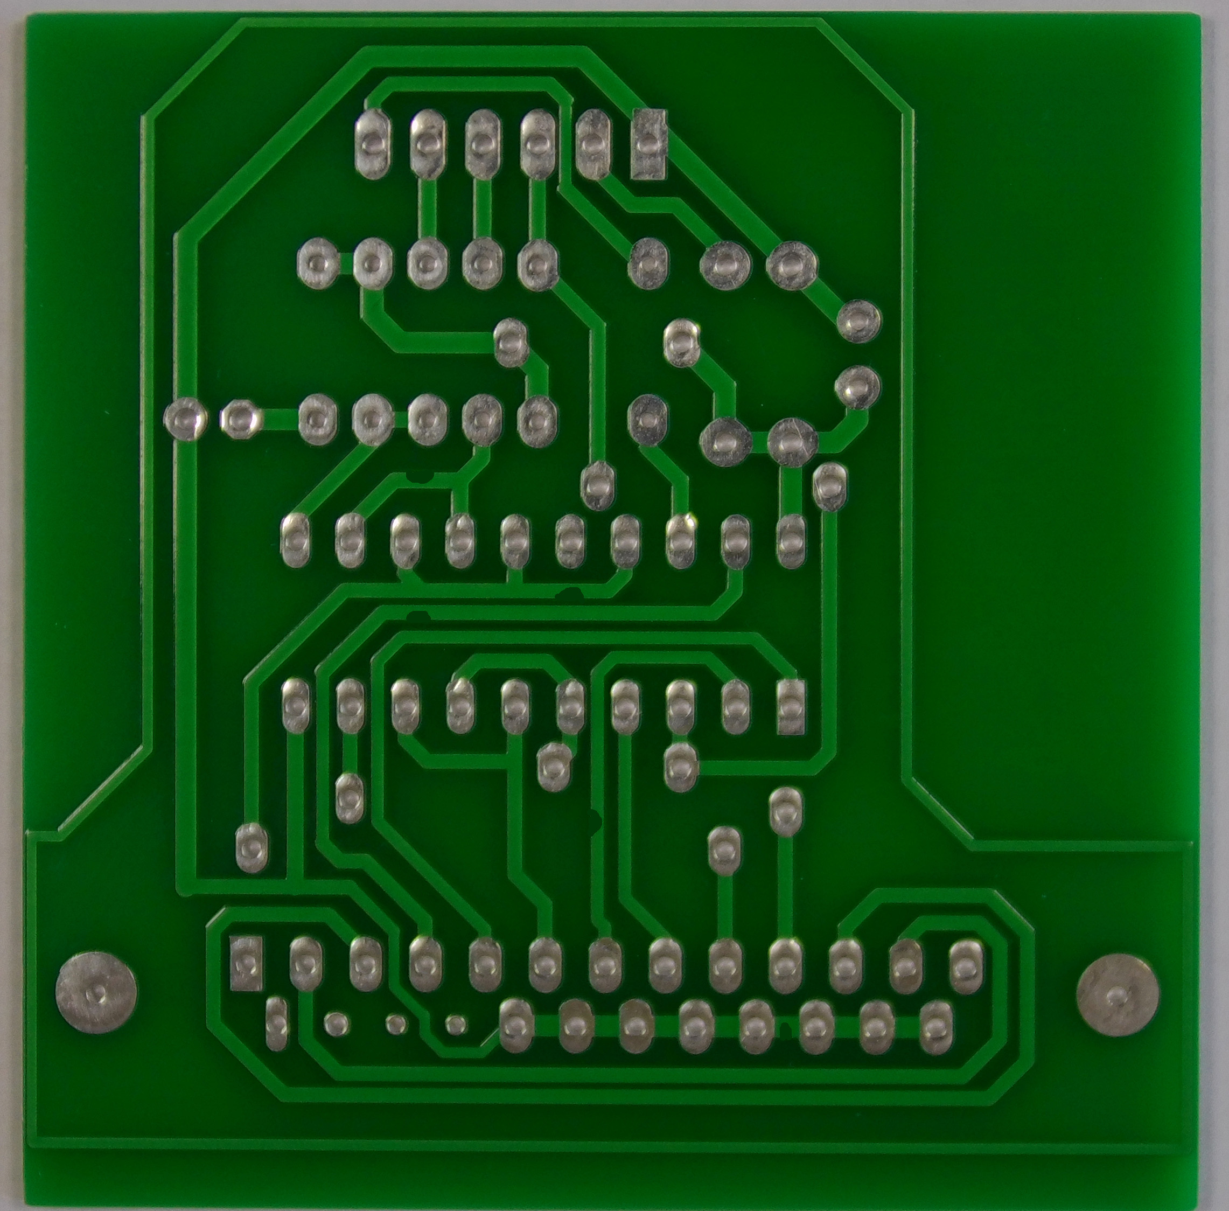


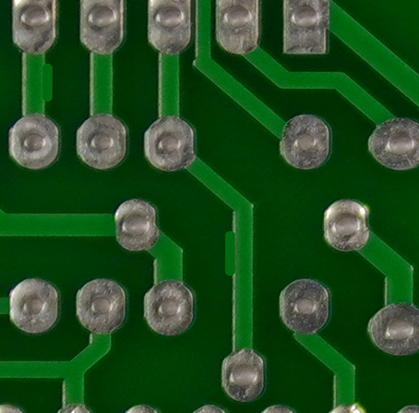

Missed_Holes Mouse_Bites Open _Circuites
Shorts Spur Spurious_Copper

Slide 5
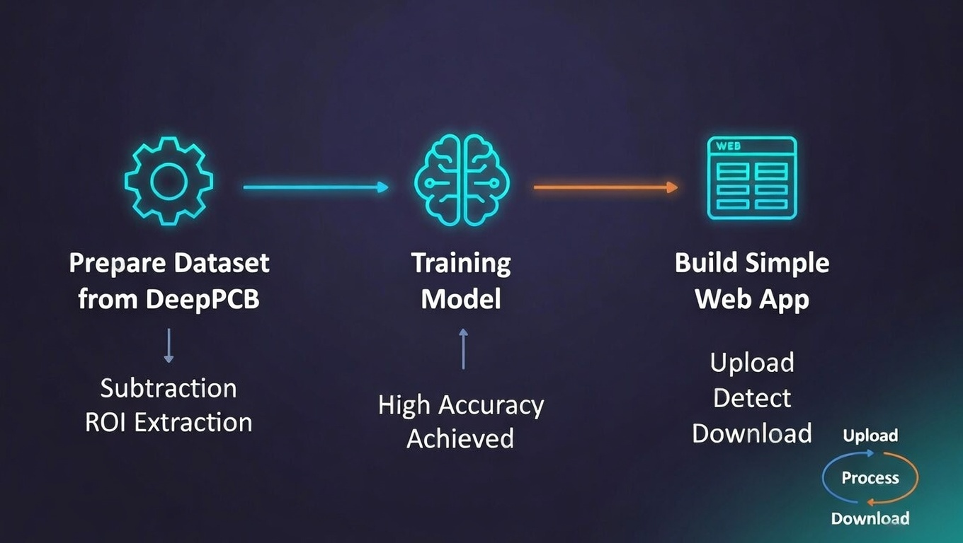
Objectives
Prepare dataset from DeepPCB using subtraction & ROI extraction
Train high-accuracy object detection model (YOLOv8)
Build simple web app for upload → detect → download annotated results
Visual: Bullet icons + small flowchart teaser

Slide 6
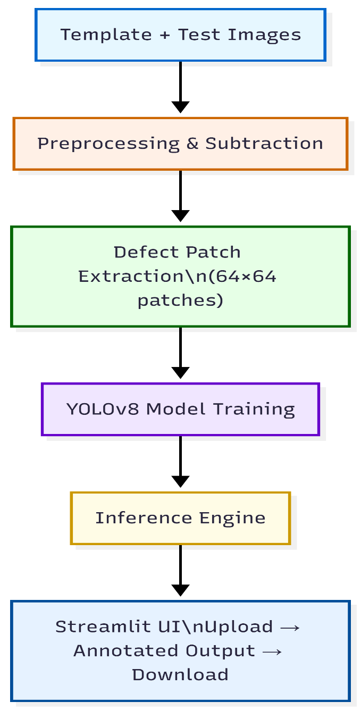
Methodology
System Architecture

Slide 7
Milestone 1 – Dataset Preparation
Dataset: DeepPCB (template-defect pairs)
Module 1: Image subtraction
Grayscale → Resize (1/4) → Gaussian Blur → Adaptive Threshold →
Subtract → Otsu
Module 2: Contour detection & ROI crop
Find contours → Filter area 1–300 → Crop 64×64 around centroid

Slide 8
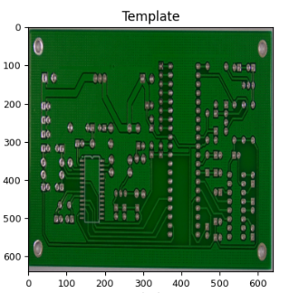
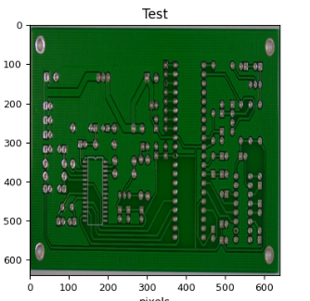
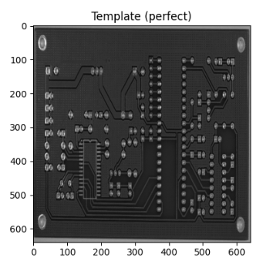
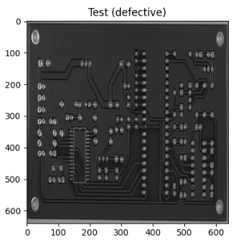
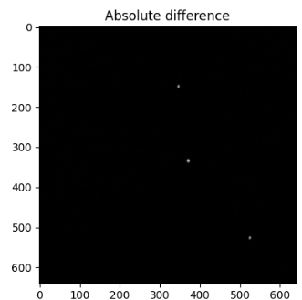
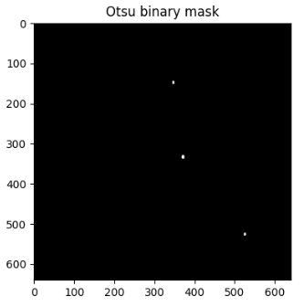
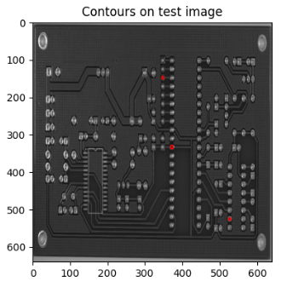

→
→
→
→

Slide 9





Grey Scale Patches
Missing_Hole Mouse_Bite Open_Circuit
Short Spur Spur_Copper

Slide 10
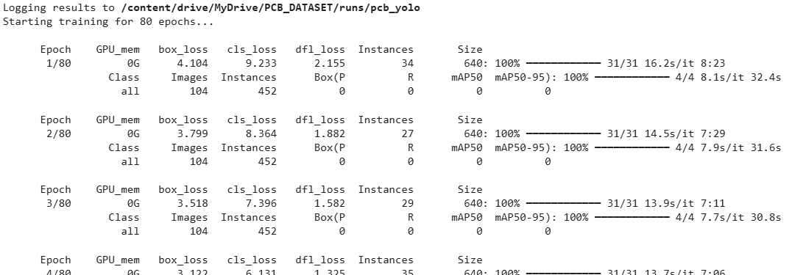
Milestone 2 – Model Training & Evaluation
Switched from EfficientNet to YOLOv8n (for efficient detection accuracy)
Steps:
Combine patches → XML → YOLO labels → Train/val/test split
Train: 80 epochs, batch 16, imgsz=640
Model is applied to individual/new images → generate predictions, visualize results, compute per-image metrics

Slide 11
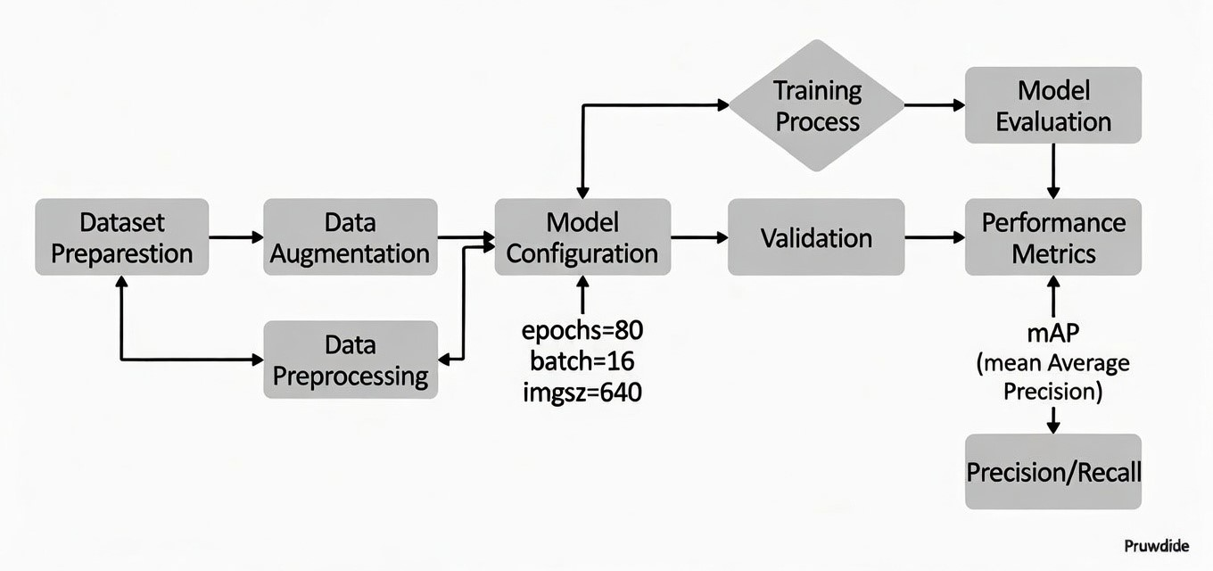
YOLO Training Process
Data Preparation + Augmentation
Model configuration is done as YOLOv8n/s/m/l/x + epochs=80, batch=16, imgsz=640
Model enters Training Loop repeats the below process till completion of training round (epoch) forward → loss → backward → optimizer → repeat.
Validation after epochs/Training round mAP calculation on val set → early stopping possible
Final Evaluation performed on following metrics Mean Average Precision , Precision, Recall, F1-score

Slide 12
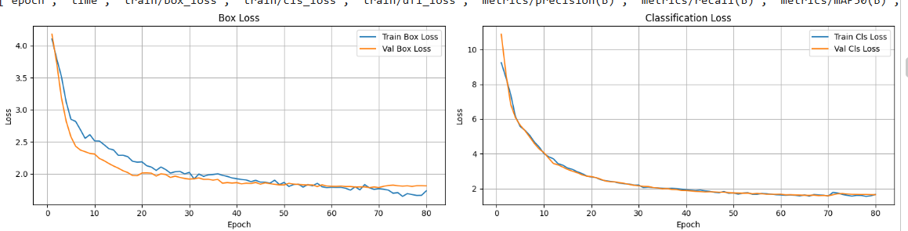
Evaluation:
Test set metrics:
Test mAP@0.5 : 0.8390 ← Primary accuracy metric (Mean Average Precision)
Test Precision (mean) : 0.8811
Test Recall (mean) : 0.7476
Test F1-score (mean) : 0.8040

Slide 13
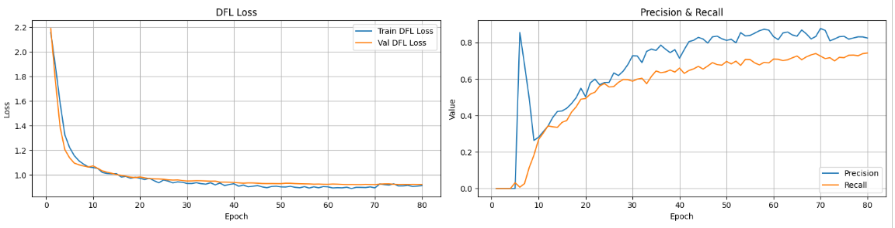
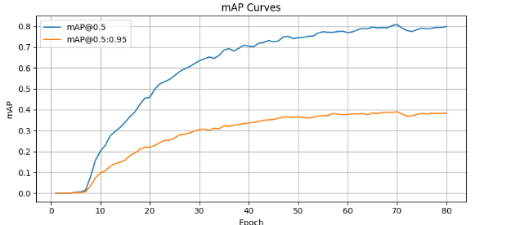

Slide 14
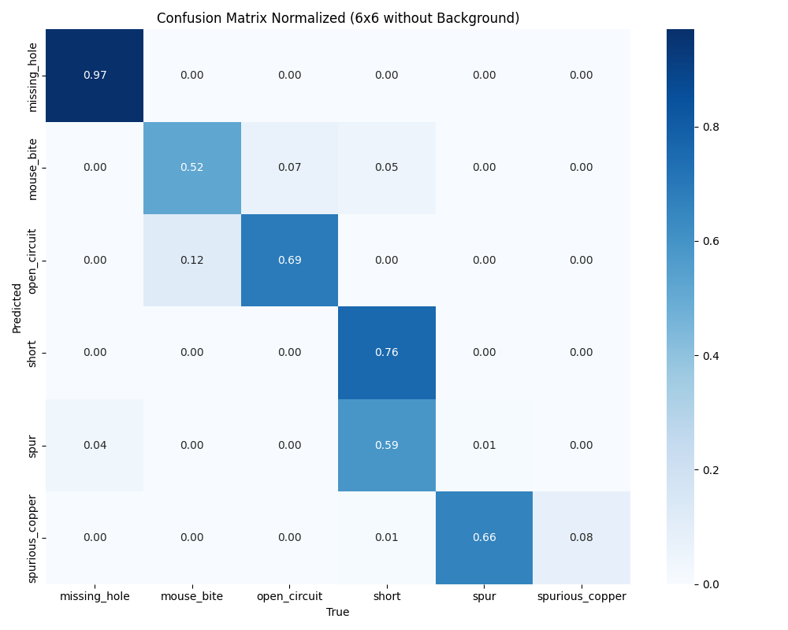

Slide 15
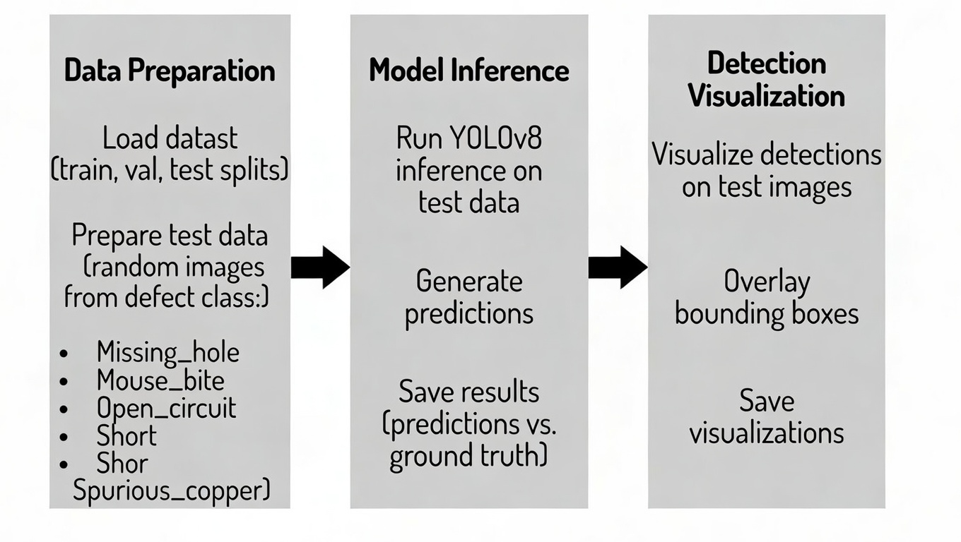
Milestone 2 – Test Inference
Load data from every defect class in random manner
Load the trained YOLOv8 model to perform inference on the selected test images
Run YOLOv8 inference on each test image to generate defect predictions
Draw red bounding boxes and labels on the original images, overlay predictions, and save the visualized results.
Save all annotated images

Slide 16
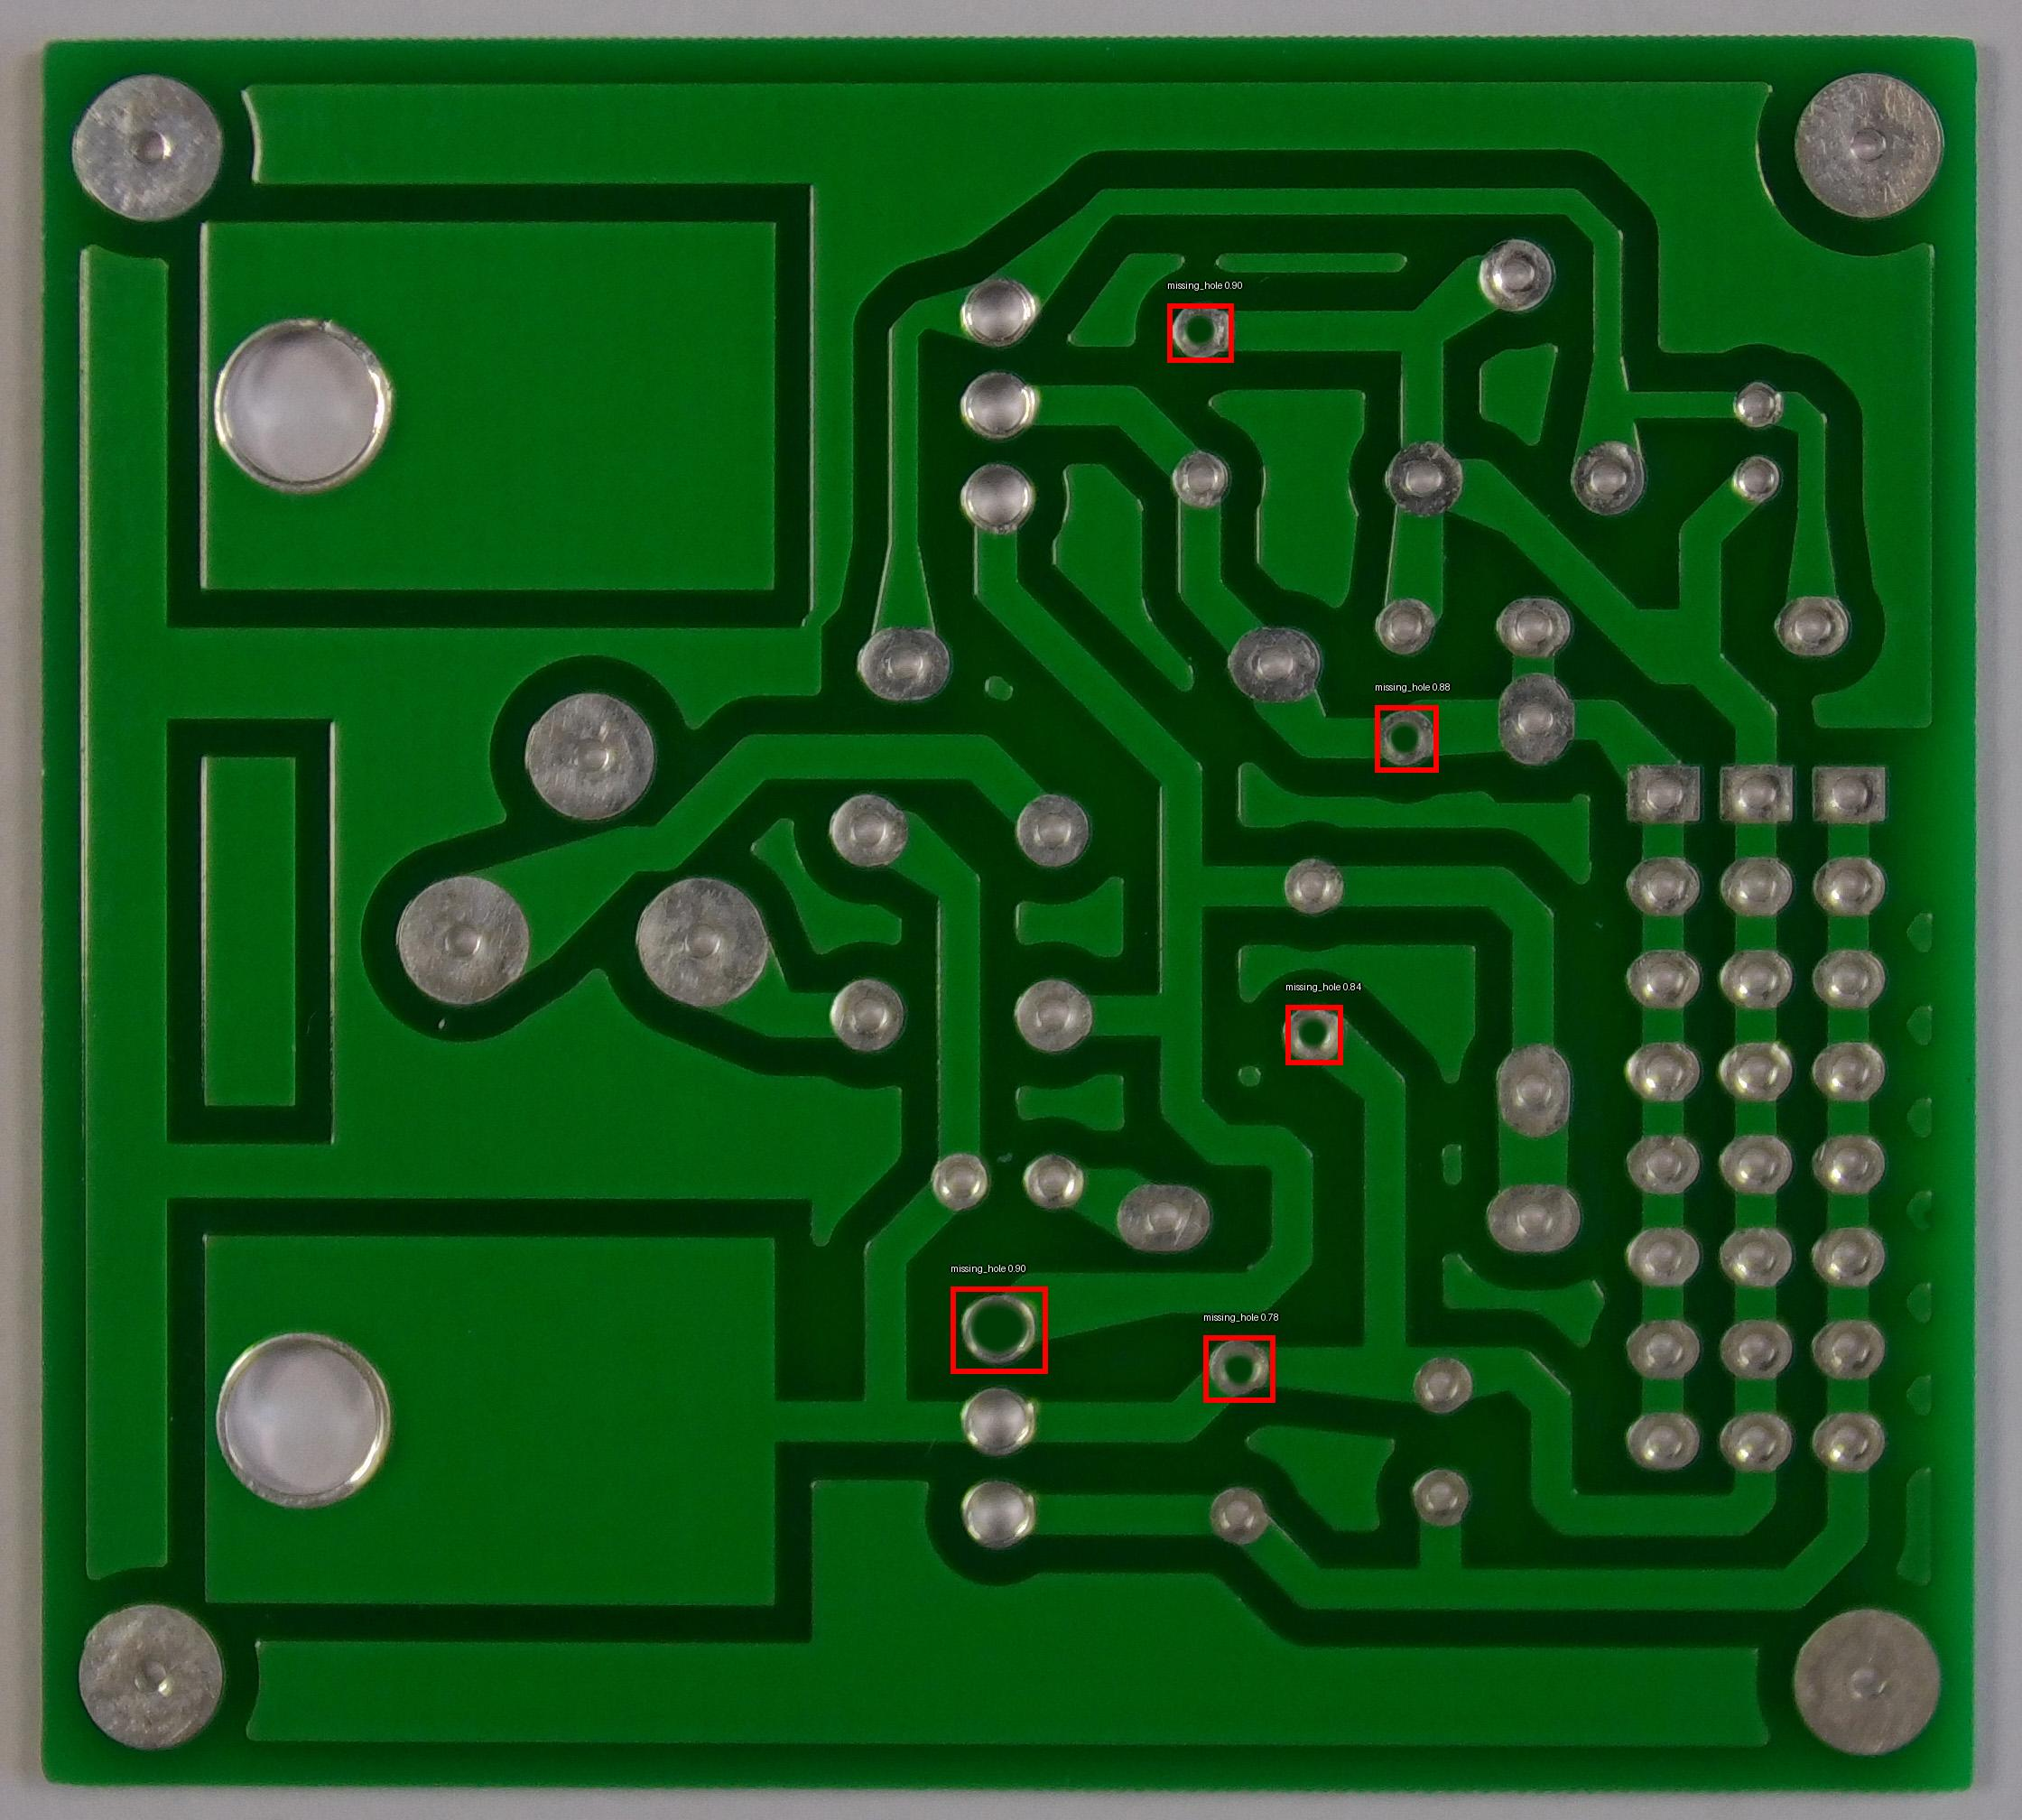
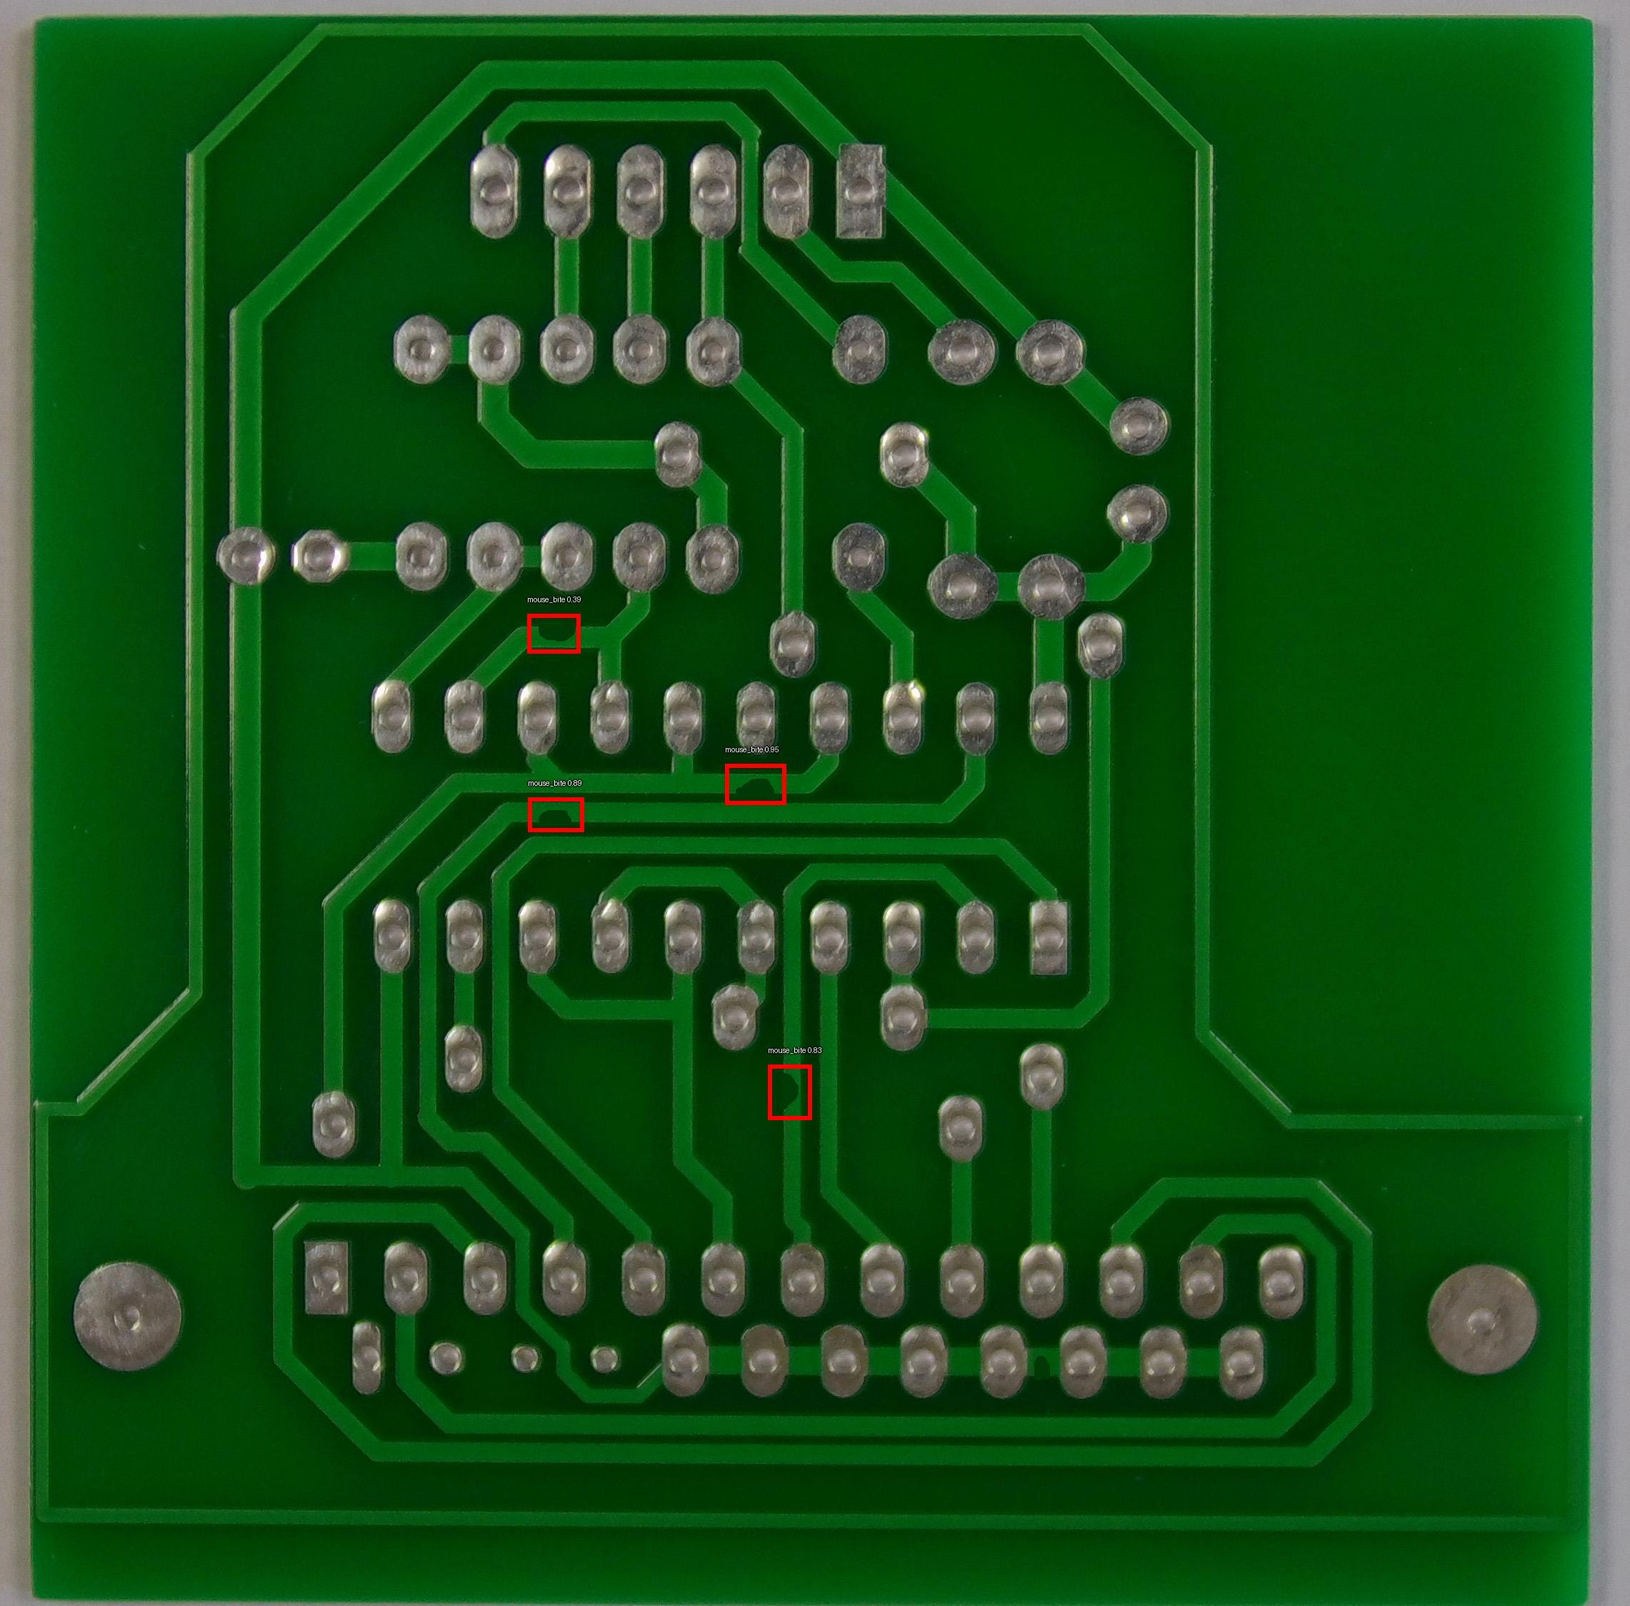
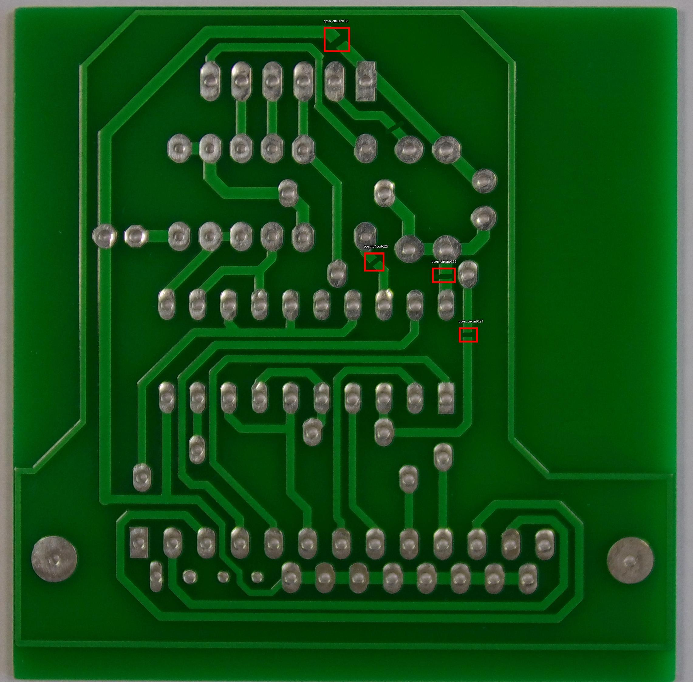
Detected Images
Missing_Hole Mouse_Bite Open_Circuit

Slide 17

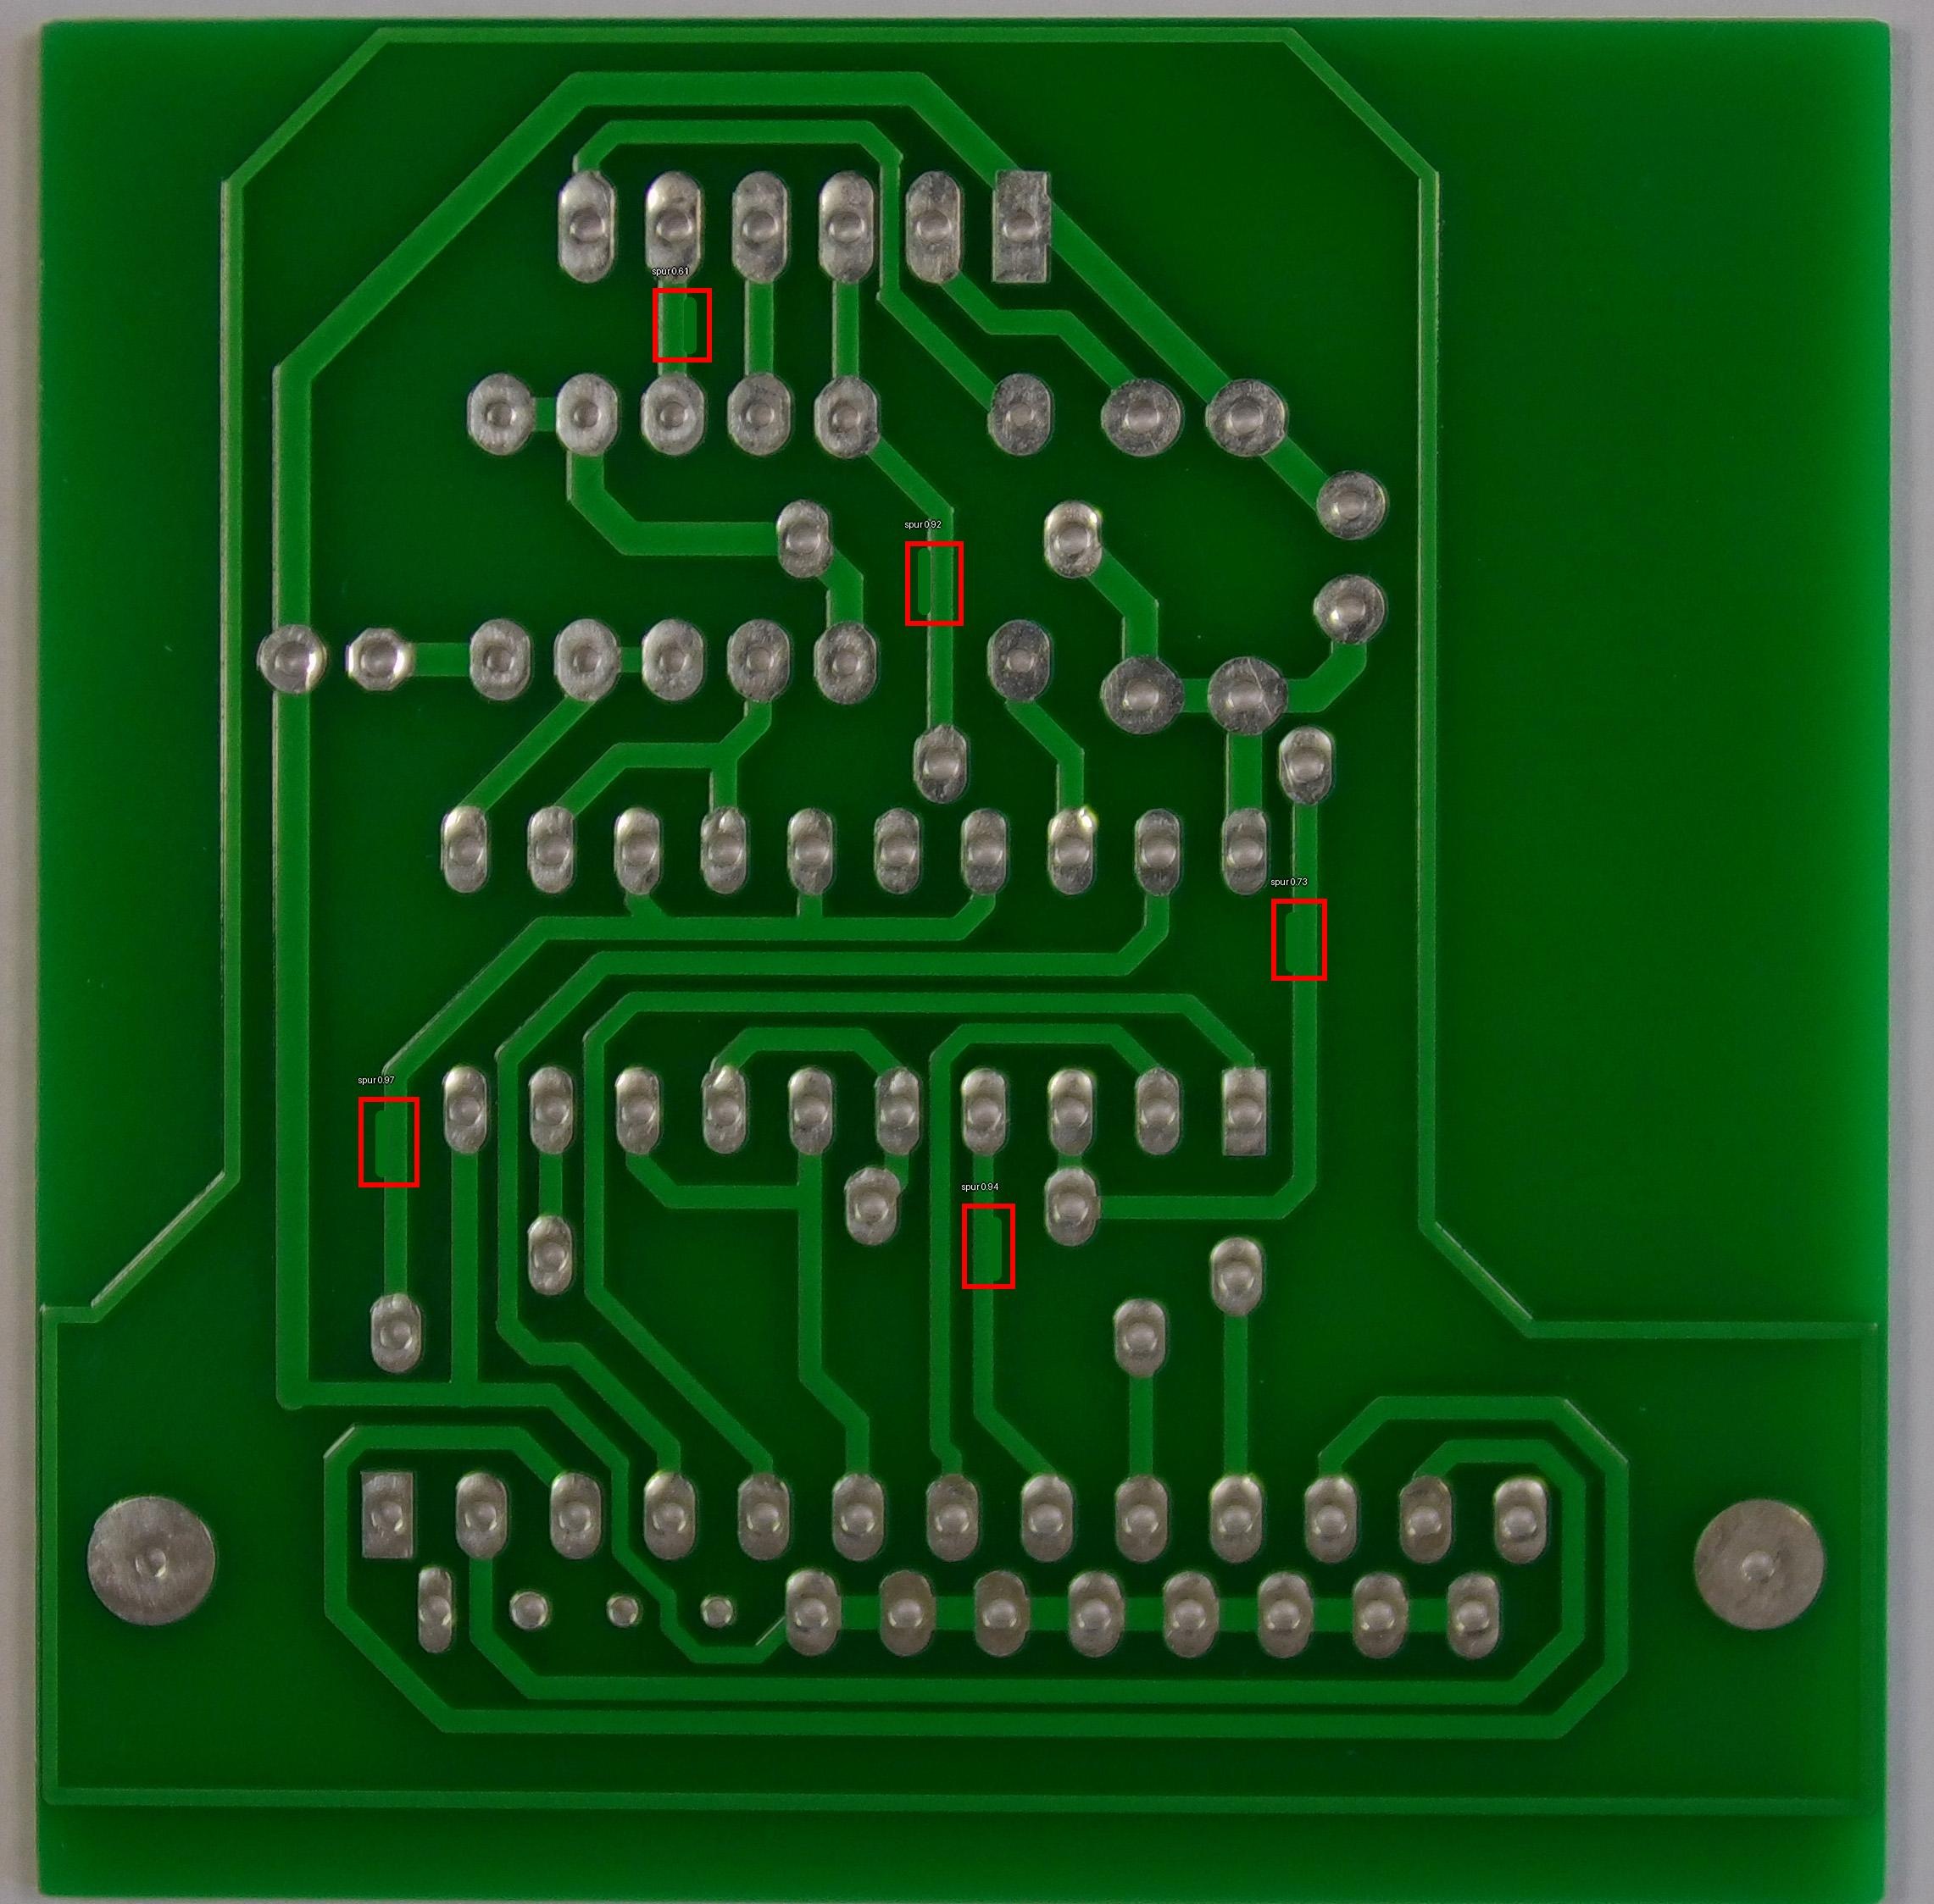
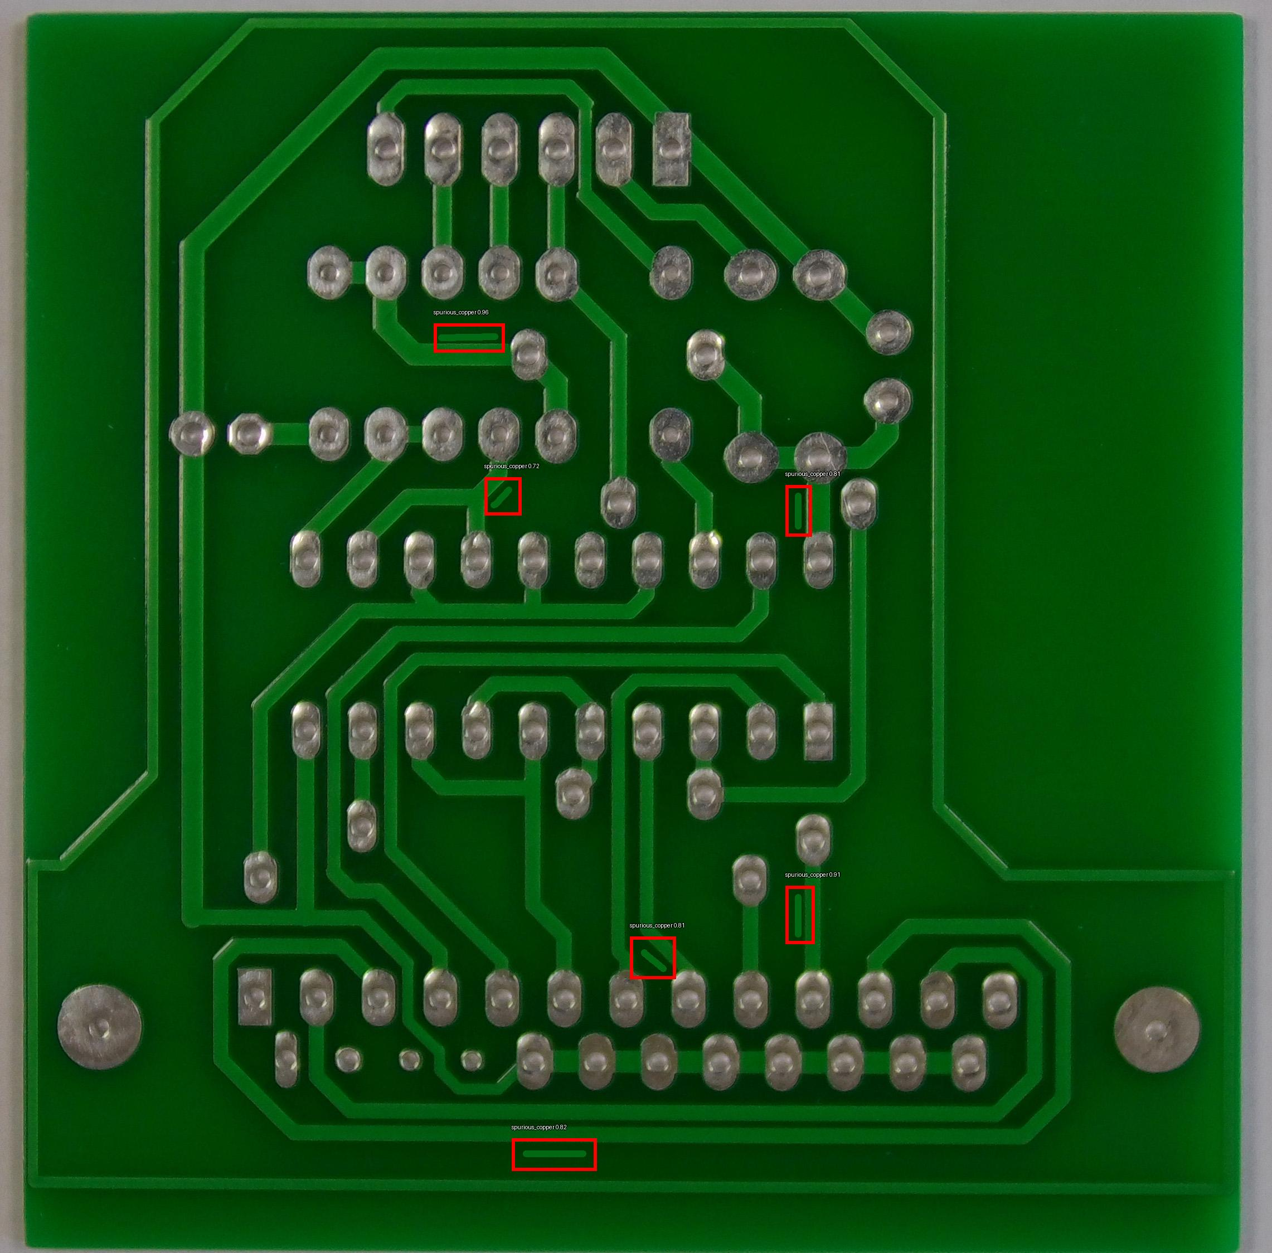
Detected Images
Short Spur Spur_Copper

Slide 18
Milestone 3 : Web Application – Streamlit UI
Streamlite UI is for frontend web application
Upload PCB image (.jpg/.png)
Real-time YOLOv8 detection
Side-by-side: Original vs Annotated
Defect table (class + confidence)
Download annotated image
Style: Thick red boxes (width=10), large bold white labels with black outline

Slide 19
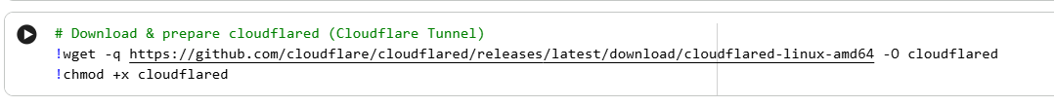

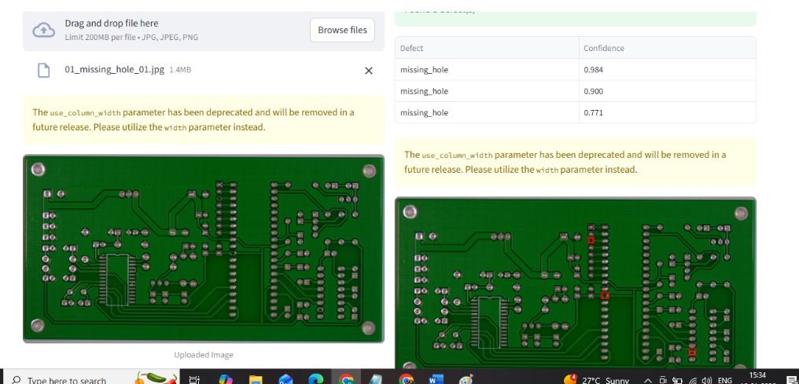
Results

Slide 20
Conclusion
Built end-to-end automated PCB defect detection system
Overcomes drawbacks of manual inspection & rule-based AOI
Integrated YOLOv8 nano → accurate localization & classification of 6 defects: Missing Hole, Mouse Bite, Open Circuit, Short, Spur, Spurious Copper
Switched from EfficientNet → better small/subtle defect detection
Achieved test mAP@0.5 > 0.83
Streamlit web app: real-time upload, thick red boxes + bold labels, downloadable results
Practical for industrial quality control
Demonstrates strong fusion of computer vision, deep learning & deployment

Slide 21
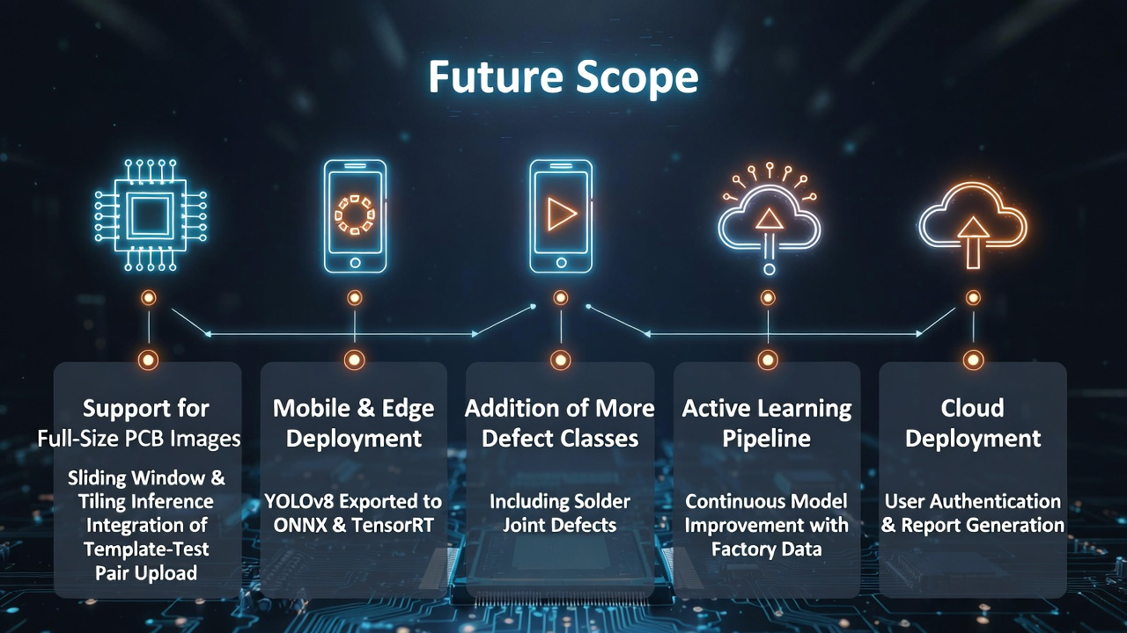
Future Scope
Support for full-size PCB images (sliding window / tiling inference)
Integration of template-test pair upload
Mobile/edge deployment (YOLOv8 export to ONNX / TensorRT)
Addition of more defect classes (e.g., solder joint issues)
Active learning pipeline for continuous model improvement using factory data
Cloud deployment with user authentication and report generation

